Slide 1
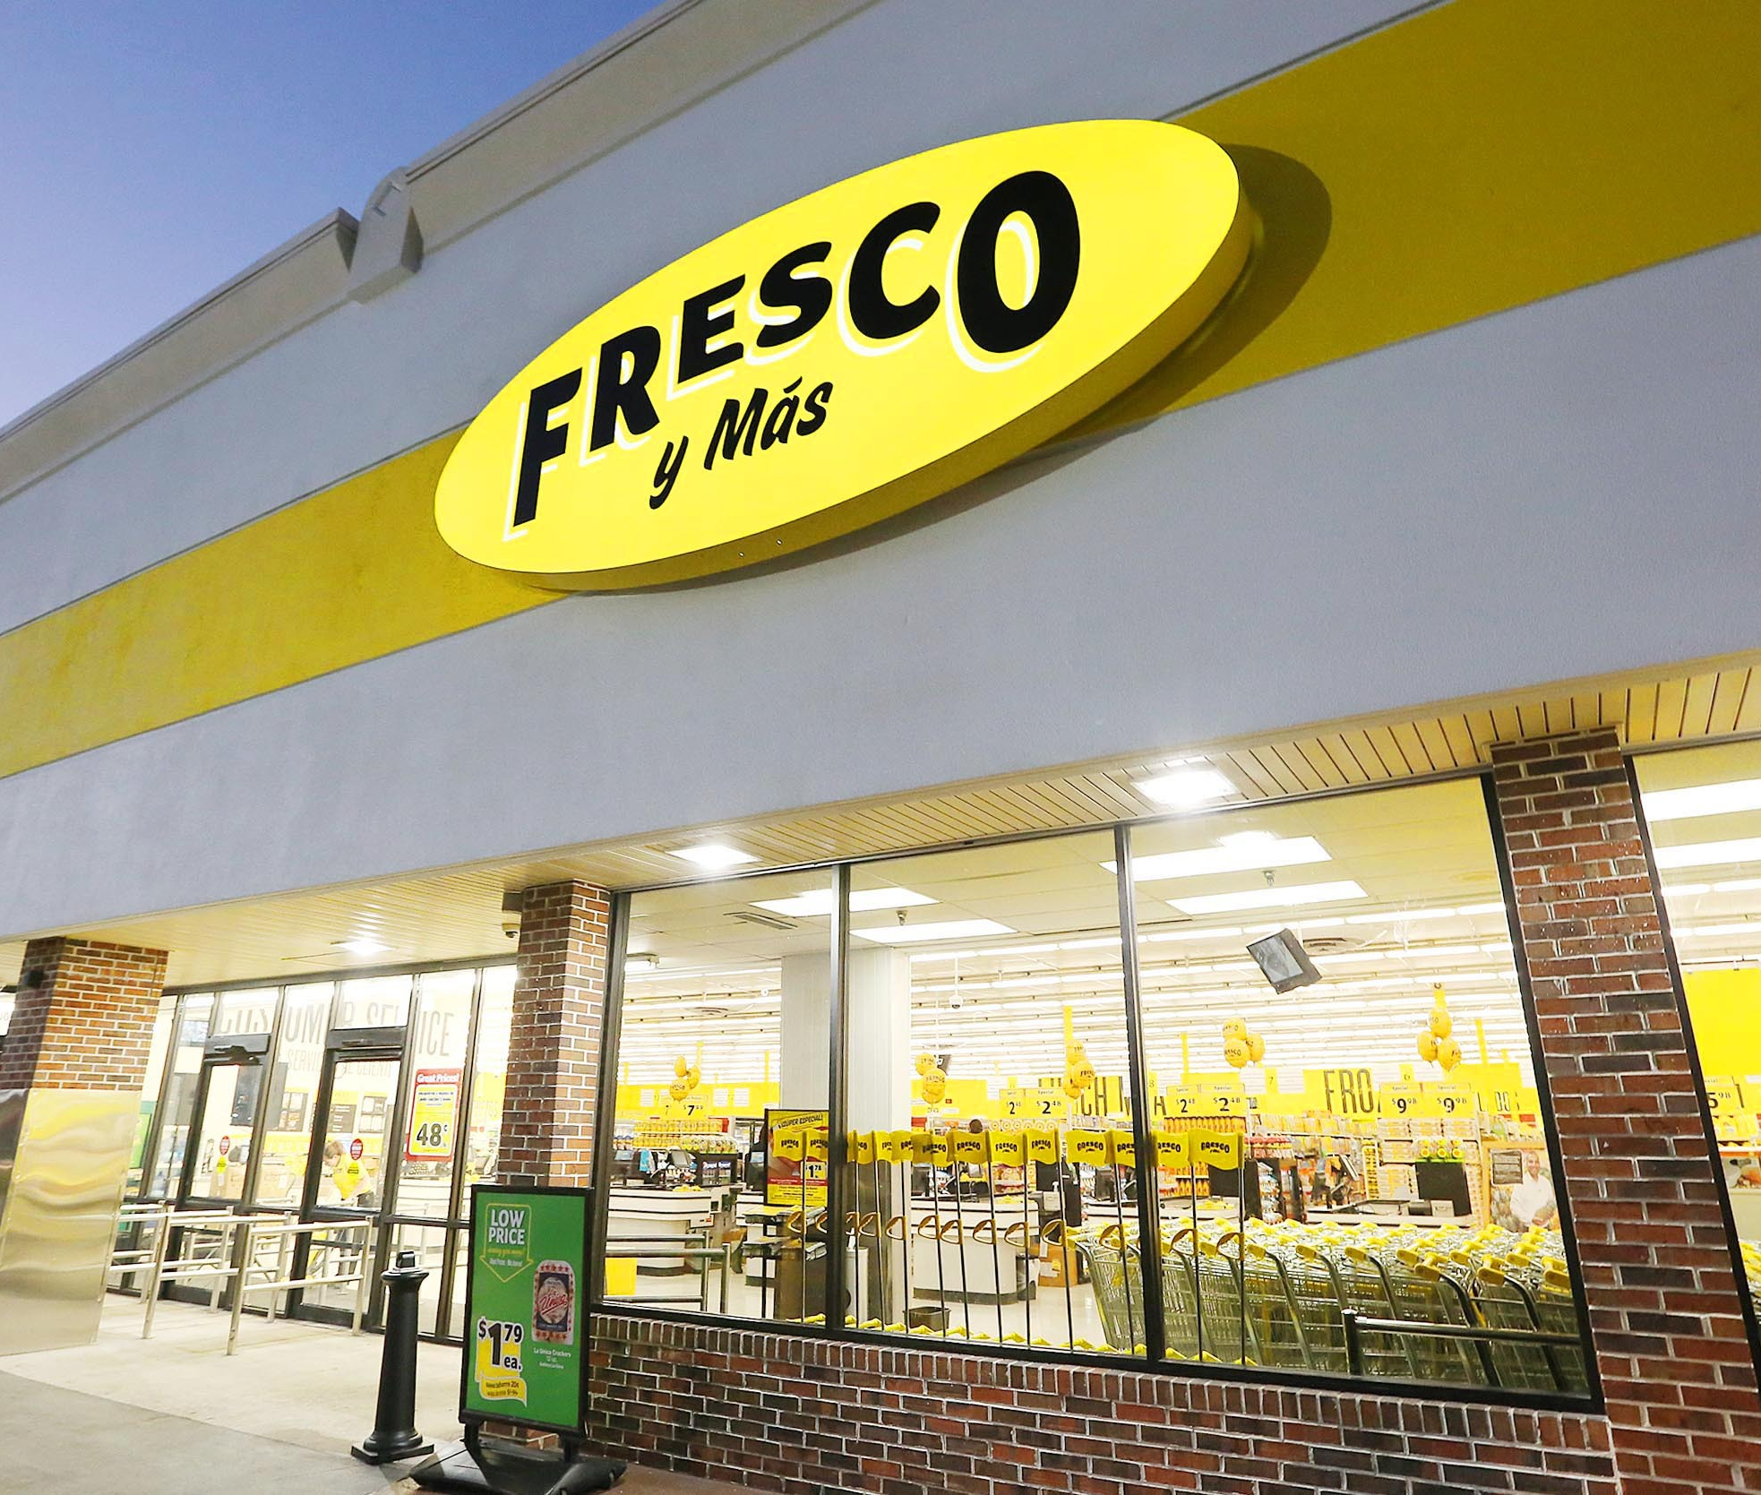
FRESCO RETAIL- PROJECT
Submitted by- Rahul Sisodia

Slide 2

Aim of the project
The data analyses Fresco Retail’s customers’ transaction data to predict return decision using various data points like customer background, payment modes, store types, product nature, etc.
The objective is to study the influence of different transaction data points and their impact on a customer’s final decision to return the product(s) bought in a transaction.

Slide 3
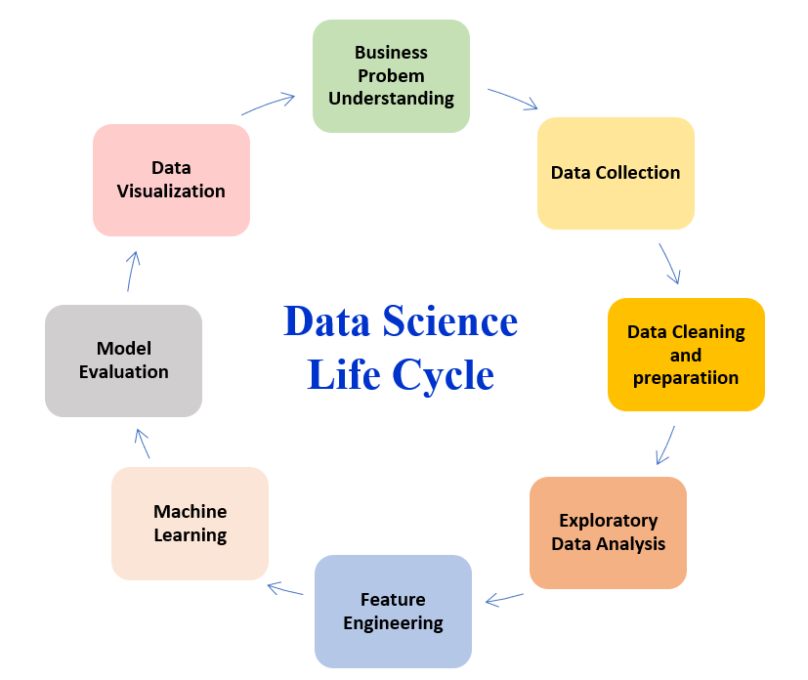
About data Set & Approach
We have 20 independent variables and one dependent variables which is "Return”
The dataset has 19597 records
Approach
Clean the data
Conduct EDA (Exploratory Data Analysis) on the cleaned Data
Uni-variate and Bi-variate Analysis
Feature Engineering
Identify the most important variables (or data parameters) that affect the final decision
Develop and Validate Samples
Model Building
Improving model accuracy
Model Comparison
Prediction

Slide 4
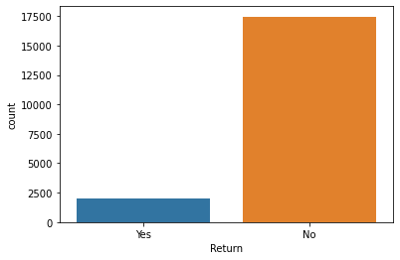
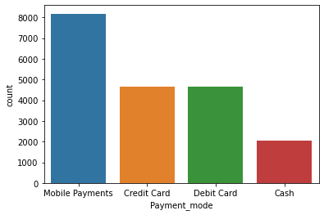
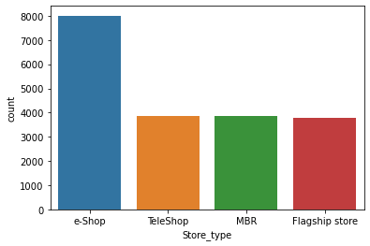
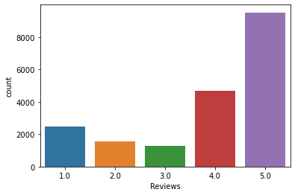
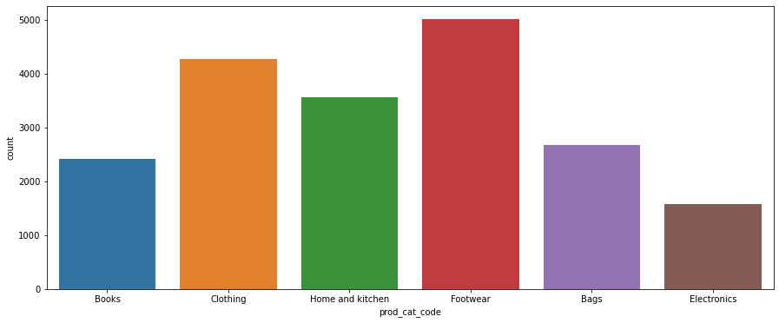
Univariate Analysis
As we seen in first graph the retuned product are very less
In Graph 2, The payment mode was done by Mobile followed by debit and credit card
In graph 3, The most of the product was bought through e-shop which is online mode
In graph4, it seems likes most of the customers were satisfied with products
In graph 5, The maximum sells of footwear products followed by clothing

Slide 5
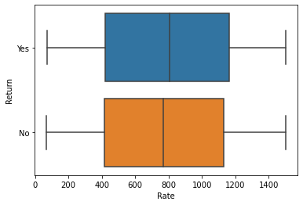
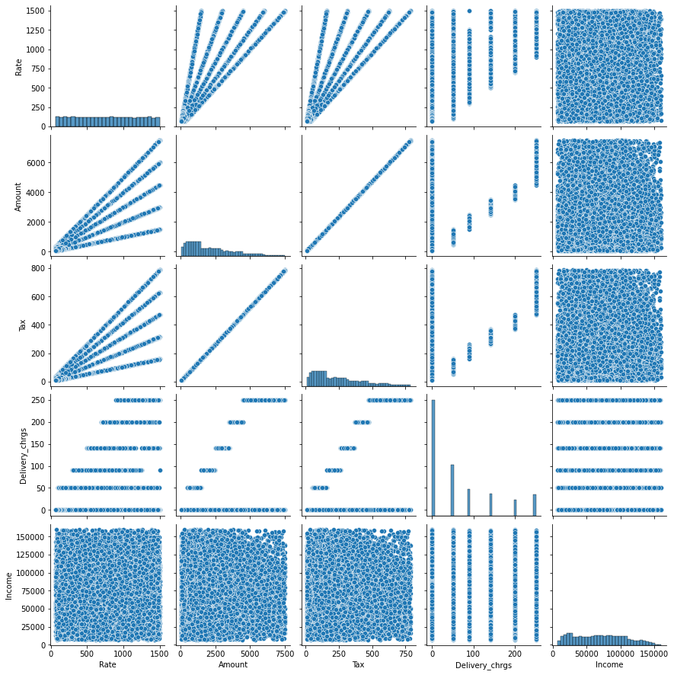
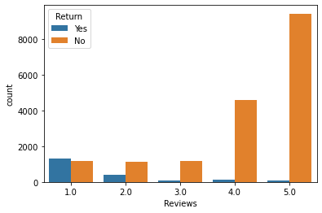
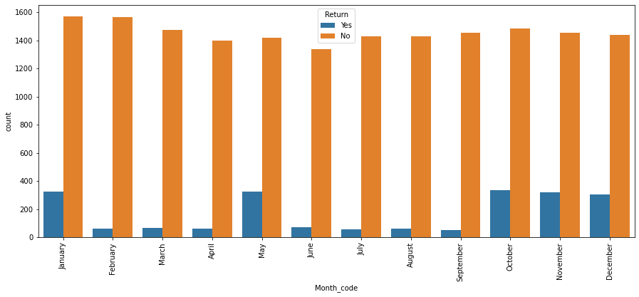
Bivariate Analysis
Most of 1 Review product was retuned by customers which is more obvious
In months of January, May, October and November most of the product was retuned
By looking at scatter graph we conclude that the amount was directly proportional to Tax
The average return ed product rate was between 800 to 900

Slide 6
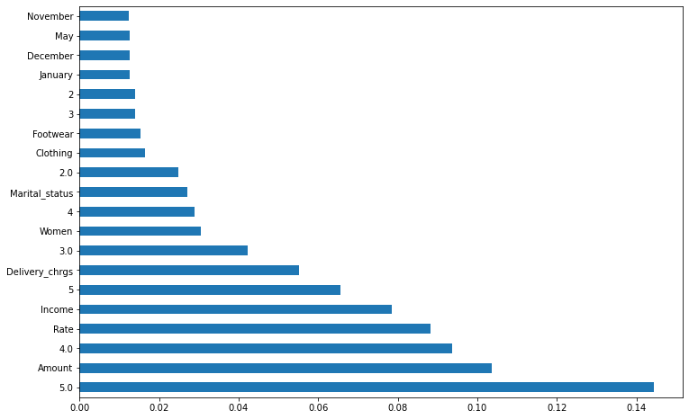
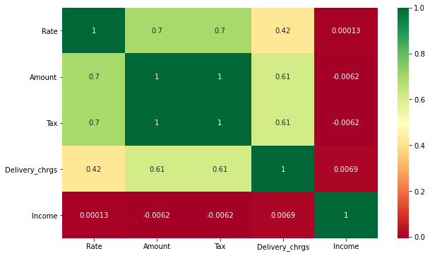
Features selections
Left graph is about Top 20 important features
As we see in right correlation graph, the independent features Tax and amount are highly correlated to each other , so we will remove one of them to avoid multicollinearity

Slide 7
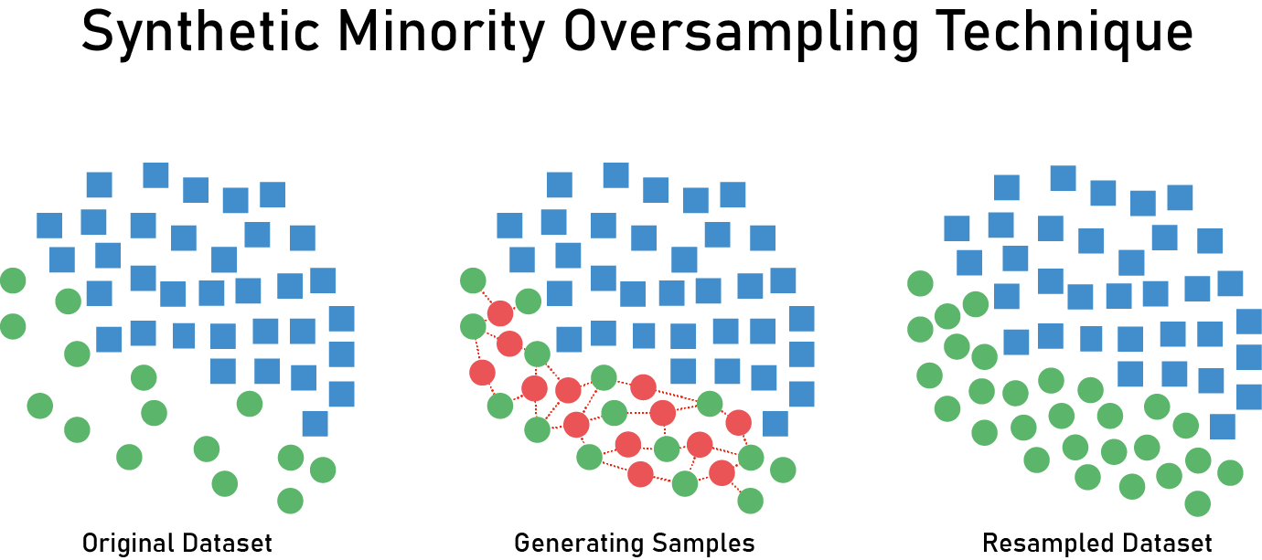
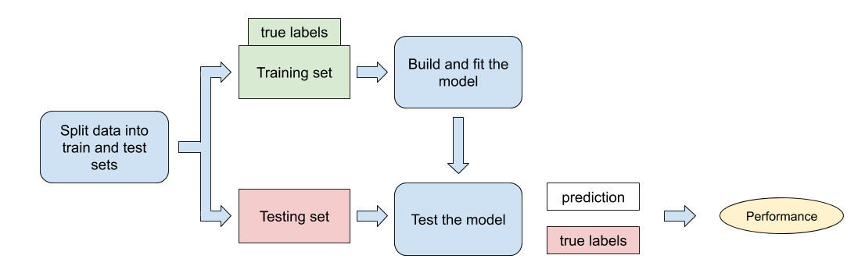
Model Building Logistic Regression
Technique of Maximum Likelihood Estimation The Maximum Likelihood Estimation (MLE) technique is used to estimate parameters in logistic regression
Use smote with oversampling to balanced the dataset

Slide 8
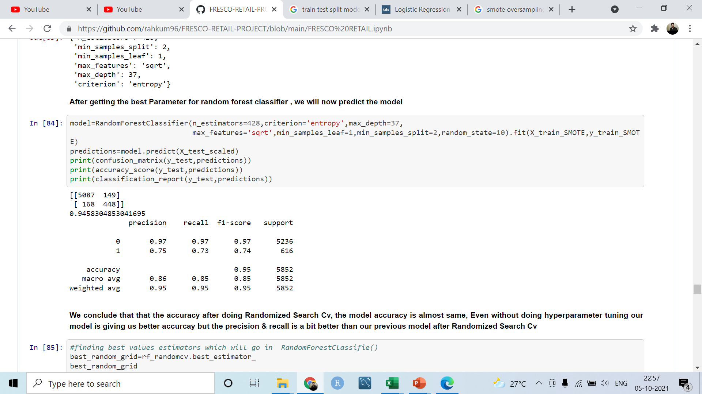
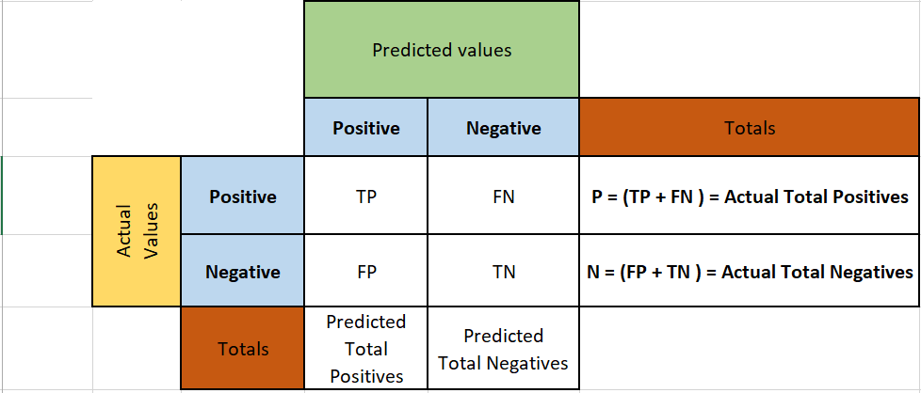
Model predictions
The Accuracy of the model is 94 %

Slide 9

Thank You

